Slide 1
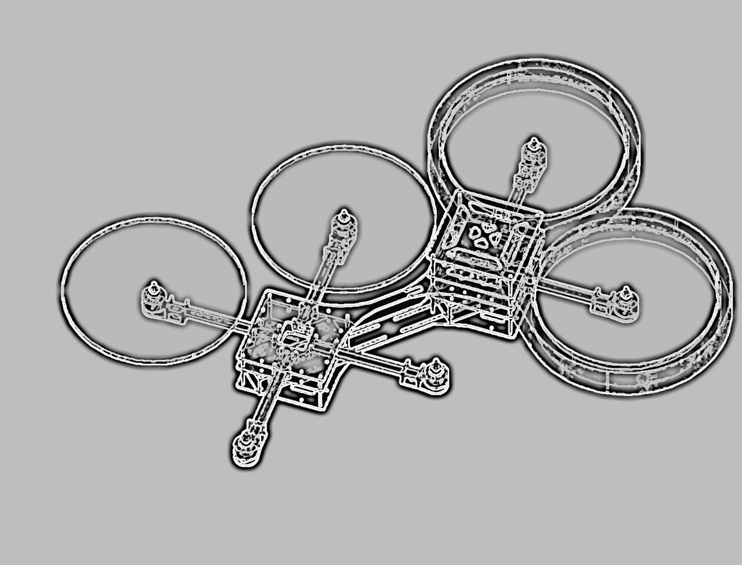

Integrated Project
Fall Semester 15/16
University of Applied Sciences Ulm
X-COPTER

Slide 2


The X-Copter Project: Table of Contents
University of
Applied Sciences
Table of Contents
Overview
Project Management
System Architecture
Hardware
Linux
Flight Controller
Challenges
Lessons Learned
START
GOAL

Slide 3
The X-Copter Project: Table of Contents
University of
Applied Sciences
Table of Contents
Overview
Project Management
System Architecture
Hardware
Linux
Flight Controller
Challenges
Lessons Learned

Slide 4


The X-Copter Project: Overview
University of
Applied Sciences
Introduction
The X-Copter is planned as an autonomous modular multicopter
Fields of application
3D Mapping
Rescue Missions
Surveillance
Parcel delivery
Movie Production

Slide 5

The X-Copter Project: Overview
University of
Applied Sciences
Customer Needs
Basic Requirements
Modularity (4/6 rotors)
Stable power supply
Sturdy construction
Remote control
Test flight
Flight Controller
Test with commercial Flight Controller
Own Flight Controller
Logging and Sensors
Evaluating sensor data
Logging of all sensor data
Visualisation on Ground Station
Future Development
3D Environment Mapping
Autonomous flight
Collision control

Slide 6
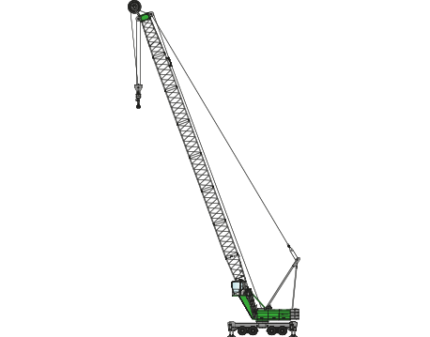
The X-Copter Project: Overview
University of
Applied Sciences
Initial state of the Project
Finished Physical model
Custom power supply circuit
Interfaces (I2C, PIOs, PWM)
Interface circuit for sensors and actors
Sensors (gyroscope, accelerometer, compass)
SoPC for the FPGA-part of DE1-SoC
Interprocessor communication with FIFOs
Drivers (partially tested)
(Some sort of USB interface)

Slide 7
The X-Copter Project: Table of Contents
University of
Applied Sciences
Table of Contents
Overview
Project Management
System Architecture
Hardware
Linux
Flight Controller
Challenges
Lessons Learned

Slide 8
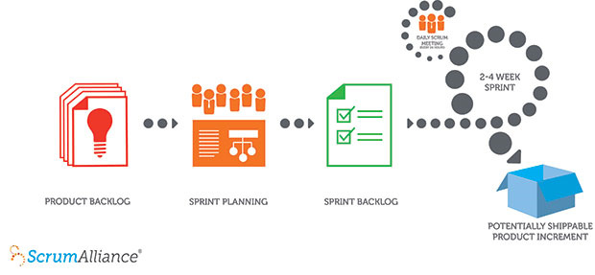
The X-Copter Project: Project Management
University of
Applied Sciences
Project Management
Scrum:

Slide 9
The X-Copter Project: Project Management
University of
Applied Sciences
Changes in Project Management
Scrum:
Positive | Negative
Daily Scrum | Sprint Planning
Taskboard | Sprint Review
 | Sprint Retrospektive
Conclusion: Scrum only works if the team meets every day

Slide 10
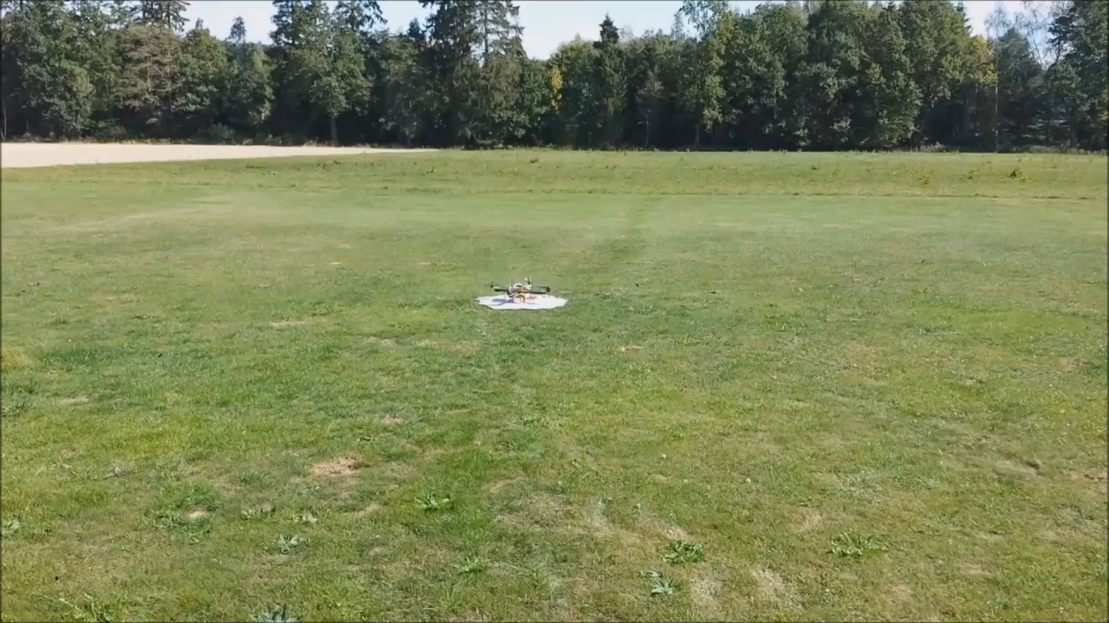
The X-Copter Project: Flight
University of
Applied Sciences
Flight test of the model:

Slide 11
The X-Copter Project: Flight
University of
Applied Sciences
Flight test of the model:

Slide 12
The X-Copter Project: Table of Contents
University of
Applied Sciences
Table of Contents
Overview
Project Management
System Architecture
Hardware
Linux
Flight Controller
Challenges
Lessons Learned

Slide 13
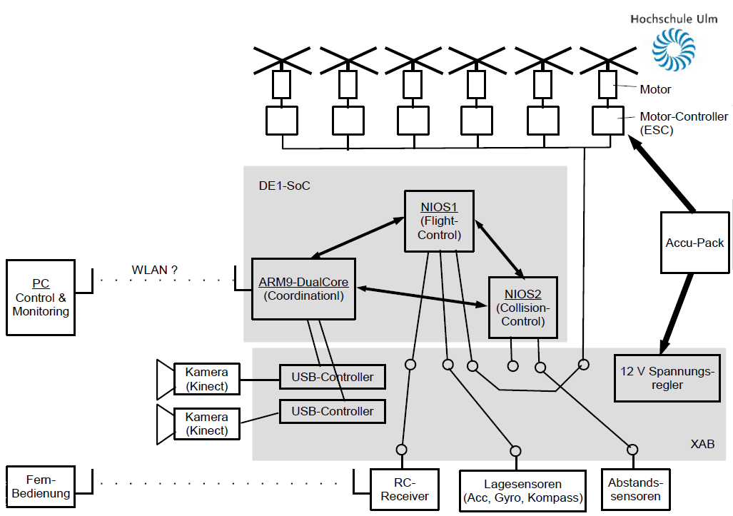
The X-Copter Project: System Architecture
University of
Applied Sciences
Old System Architecture

Slide 14
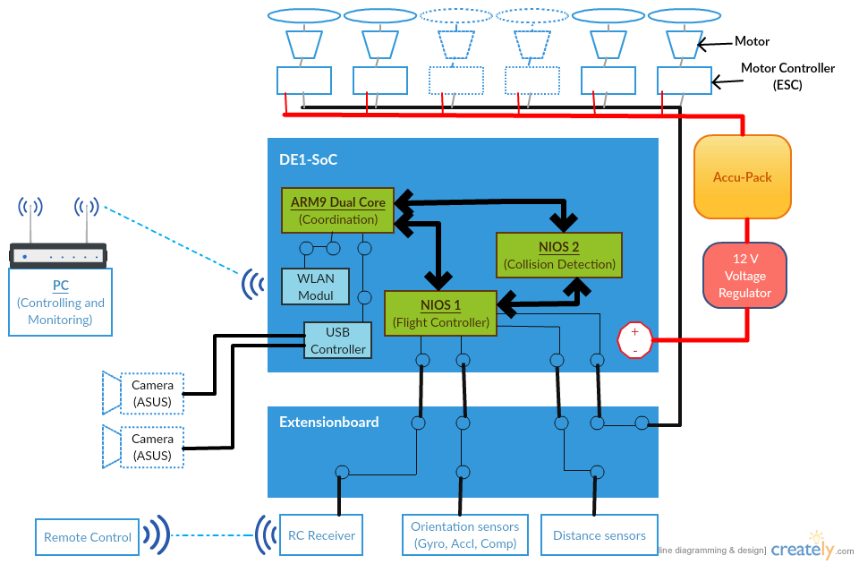
The X-Copter Project: System Architecture
University of
Applied Sciences
New System Architecture

Slide 15
The X-Copter Project: Table of Contents
University of
Applied Sciences
Table of Contents
Overview
Project Management
System Architecture
Hardware
Linux
Flight Controller
Challenges
Lessons Learned

Slide 16
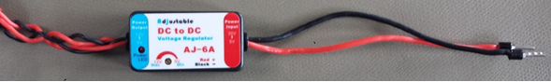
The X-Copter Project: Hardware
University of
Applied Sciences
Additional hardware
Commercial power supply
5-30 Vin
5-12Vout
max 6A output
Graupner MX-16 RC transmitter
Gr-16 2.4 GHz RC receiver

Slide 17
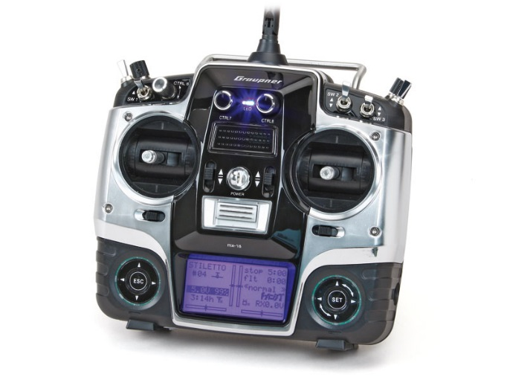
The X-Copter Project: Hardware
University of
Applied Sciences
RC Receiver
Graupner MX-16 HoTT Transmitter
GR-16 2.4 GHz Receiver supporting
Sum signal (PPM)
Serial sum signal (SUMD)
Support for telemetry data

Slide 18
The X-Copter Project: Hardware
University of
Applied Sciences
Graupner SUMD protocol
Signal can be read by UART
Updating every 10 ms
16 bit output resolution
Fairly easy to parse
In contrast to PPM no real-time encoding required.

Slide 19
The X-Copter Project: Table of Contents
University of
Applied Sciences
Table of Contents
Overview
Project Management
System Architecture
Hardware
Linux
Flight Controller
Challenges
Lessons Learned

Slide 20
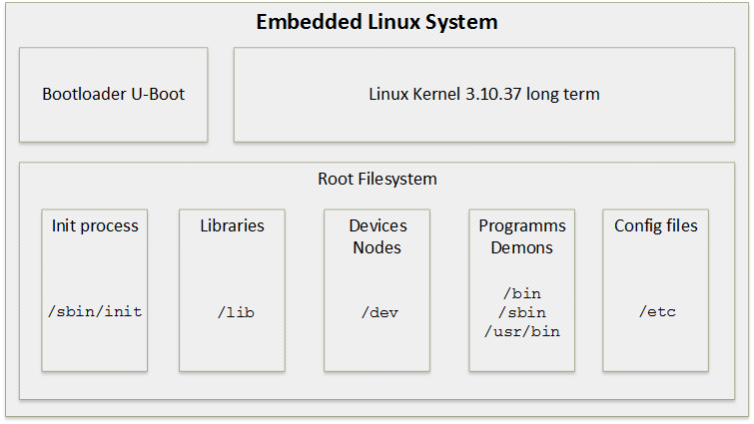
The X-Copter Project: Linux
University of
Applied Sciences
Buildroot

Slide 21
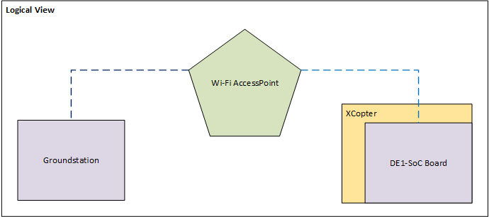
The X-Copter Project: Linux
University of
Applied Sciences
Wi-Fi
Automatically connects at start up
Stable link to access point
Encrypted communication with WPA2

Slide 22
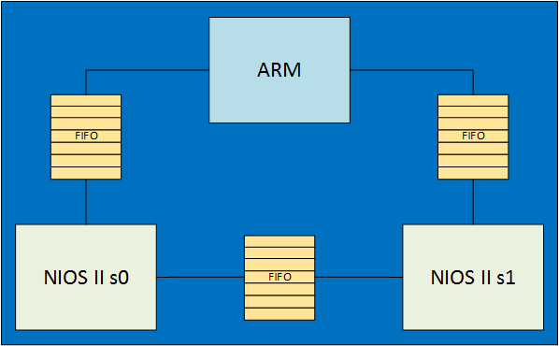
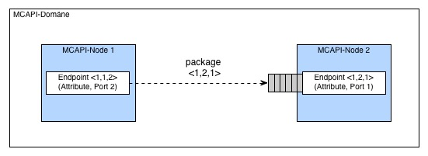
The X-Copter Project: Linux
University of
Applied Sciences
MCAPI
Interprocessor communication
FIFO based

Slide 23
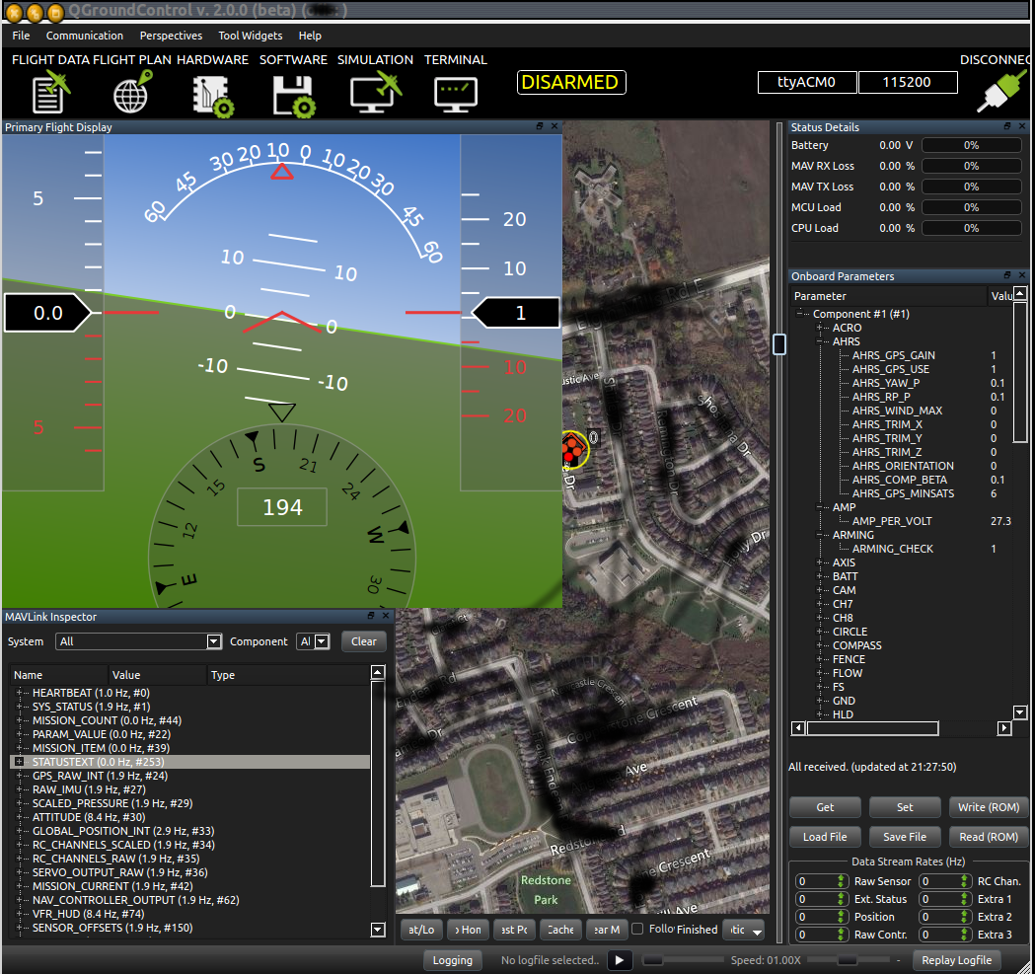

The X-Copter Project: Linux
University of
Applied Sciences
MAVLink
Micro Air Vehicle Communication Protocol
Communication protocol between UAV and ground station
C library for header based messaging
QGroundControl

Slide 24
The X-Copter Project: Table of Contents
University of
Applied Sciences
Table of Contents
Overview
Project Management
System Architecture
Hardware
Linux
Flight Controller
Challenges
Lessons Learned

Slide 25
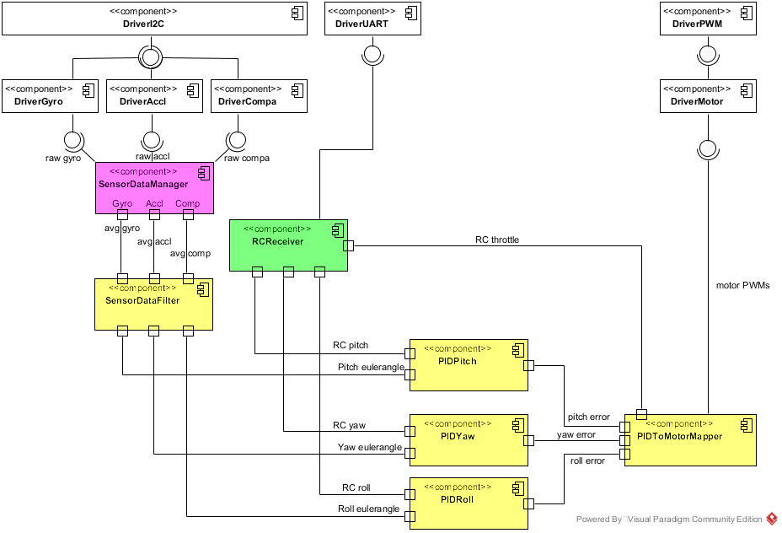
The X-Copter Project: Flight Controller
University of
Applied Sciences
System Architecture

Slide 26
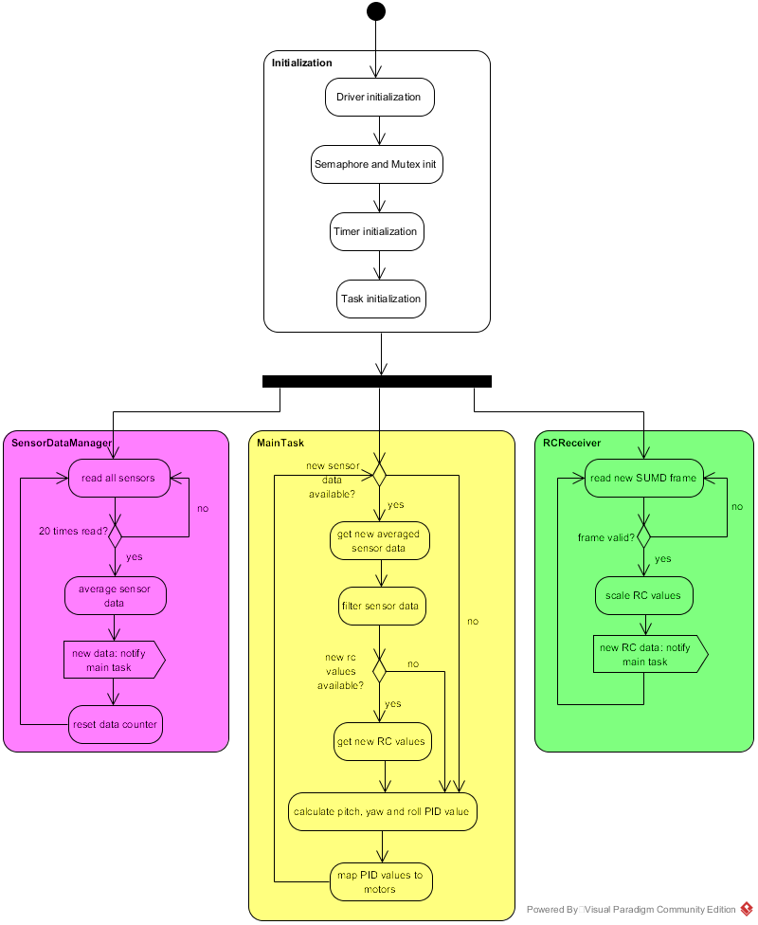
The X-Copter Project: Flight Controller
University of
Applied Sciences
Program Flow
Init state
Driver, Mutex, Timer & Task initialization
Split into three tasks
Sensor Data Manager Task
RC Receiver Task
Main Task

Slide 27
The X-Copter Project: Flight Controller
University of
Applied Sciences
Dataflow
Sensors
raw sensor data
Sensor Data Manager
averaged sensor data
Sensor Data Filter
euler angles
Motors
euler angles
PIDs
motor PWM signals
Remote Control
PID error values
throttle
PID To Motor Mapper

Slide 28

The X-Copter Project: Flight Controller
University of
Applied Sciences
Logging
Storing data after each control cycle in a queue
Logger task sends content of Queue via MCAPI
Logging is not enabled jet.
Architecture is considering the Logger

Slide 29
The X-Copter Project: Flight Controller
University of
Applied Sciences
PID regulators

Slide 30
The X-Copter Project: Flight Controller
M
University of
Applied Sciences
PIDToMotorMapper
PIDToMotorMapper
M
M
First step:
M
Second step:
$$C_{th}∗throttle+ C_{mix}∗{PID}_{mix}=100\%$$

Slide 31
The X-Copter Project: Table of Contents
University of
Applied Sciences
Table of Contents
Overview
Project Management
System Architecture
Hardware
Linux
Flight Controller
Challenges
Lessons Learned

Slide 32
The X-Copter Project: Challenges
University of
Applied Sciences
Flight controller
At this point in time the output values of the motor mapper module aren´t correct!
Possible errors:
Wrong input ranges because of a wrong conversion
Logical error in the module itself

Slide 33
The X-Copter Project: Challenges
University of
Applied Sciences
Linux
Underestimated the complexity
Implementation of WIFI
USB Controller
MAVLINK & MCAPI

Slide 34
The X-Copter Project: Challenges
University of
Applied Sciences
General Challenges & Problems
Organizing the team
Time Management
File Management
NIOS Eclipse doesn‘t work with Git
SCRUM

Slide 35
The X-Copter Project: Challenges
University of
Applied Sciences
Improvements
Initial state | Actual state
Wrong USB Hardware | No USB Controller
Power supply doesn‘t work | Power supply works
No test flight | Successful flight test
- | In principle connection to ground station established
- | Working concept with our own flight controller

Slide 36
The X-Copter Project: Table of Contents
University of
Applied Sciences
Table of Contents
Overview
Project Management
System Architecture
Hardware
Linux
Flight Controller
Challenges
Lessons Learned

Slide 37
The X-Copter Project: Lesson Learned
University of
Applied Sciences
Lesson Learned
Do not postpone things with unknown risks
Teamwork
Time calculations
Regularly team meeting
Scrum only in fulltime job
Previous documentations are important
Notes:
Do not postpone things with unknown risk interface+functionality of mapper
Teamwork we were forced to work as a team
Regularly team meeting for overview
Generous time calculations little task → much time

Slide 38

The X-Copter Project: Finish
University of
Applied Sciences
Thank you for listening
Notes:
Do not postpone things with unknown risk interface+functionality of mapper
Teamwork we were forced to work as a team
Regularly team meeting for overview
Generous time calculations little task → much time

